Slide 1
Map Reduce
kumar

Slide 2
Introduction
A High level abstracted framework for distributed processing of large datasets
Fault Tolerant , Parallelization
Computation consists of two phases
Map
Reduce
A Master-Slaves architecture
Computations occurs in multiple slave nodes
And it tries to provide data locality as much as possible.

Slide 3
Daemons
JobTracker
Client submits the computation to JobTracker
Assign a task to the TaskTracker who has free slots and where data is stored if possible
It tries to provide data locality as much as possible.
TaskTracker
Spawns a JVM process for each input split as directed by Job Tracker
Send periodic heartbeats to Job Tracker

Slide 4
Terminology
Job
A complete user defined computation or program
Tasks
A subset of computation
Can be either execution of MAP or REDUCE
Task Attempt
An attempt to run a task.
If an attempt fails, Job Tracker tries to start an another task attempt for the same task.
By Default, total number of task attempts for a task is four

Slide 5
Anatomy of MR code
Mapper - a Java class to be extended by the developer
Methods – setup, map, run, cleanup
Map method takes a key value and can emit zero or more intermediate key value pairs depending upon the logic implemented by the developer
A JVM running Mapper is launched for each input split.
Reducer – a Java class to be extended by the developer
Methods – setup, reduce, run, cleanup
Reduce method takes a (intermediate key-list of values) and can emit zero or more key value pairs depending upon the logic implemented by the developer
Driver
Configures the job and submits the job to the cluster from the client.

Slide 6
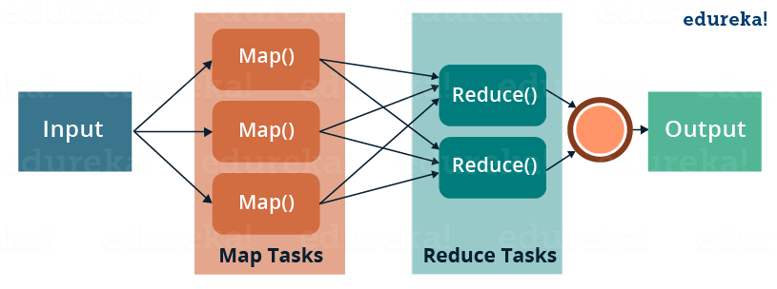

Slide 7
Writables
What is Serialization??
the process of converting a data structure or object state into a format that can be stored (for example, in a file or memory buffer, or transmitted across a network connection link) and "resurrected" later in the same or another computer environment Why a separate framework instead of java serialization?
* Writables in Hadoop are present for serialization
1.Compact
2.Fast
3.Extensible
4.Interoperable

Slide 8
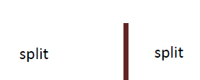


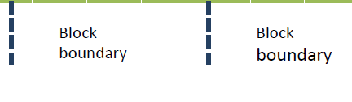

Block vs. split

Slide 9
Partitioner
•It decides which key (with its associated value) goes to reducer.
•By default its HashPartitioner.
• hashes a record’s key to determine which partition (and thus which reducer) the record belongs in
•Number of Partitions is equal to the number of reducers.
public class HashPartitioner<K, V> extends Partitioner<K, V> {
public int getPartition(K key, V value, int numReduceTasks) {
return (key.hashCode() & Integer.MAX_VALUE) % numReduceTasks;
}
}

Slide 10
Custom Partitioner
Need Customer partitioner for better load balancing(performance)
To Write a partitioner, follow the steps
Extend partitioner class
Override the method getPartition
input – key,value,number of Reducers
Output –0 to n-1( where n - number of reducer)
job.setPartitionerClass(<yourclassname.class>)

Slide 11
Combiner
To Reduce the intermediate data from mapper to reducer
To reduce Network IO and Disk IO
Runs on a single mapper output(like a mini-reducer)
Extends the Reducer class (new API)
Job.setCombinerClass(*.class);
Combiner may or maynot run
Its better to use identical combiner and reducer when both are commutative as well as associative functions

Slide 13
WritableComparable
A WritableComparable is a Writable which is also Comparable
Two WritableComparables can be compared against each other to determine their ‘order’
Keys must be WritableComparables because they are passed to the Reducer in sorted order
We will talk more about WritableComparable later
IntWritable LongWritable Text WritableComparable Writable
Defines a sort order. All keys must be WritableComparable
Defines a de/serialization
protocol. Every data type in
Hadoop is a Writable

Slide 14
Streaming API
To use other languages for writing MR
Python, perl, ruby
RAD, use of existing libraries
Use stdin, stdout for input & output respectively
TextInputFormat –default -- without key
MR emits Key(tab)value
No iterators as that of Java- developers have to make sure to detect change in key
bin/hadoop jar contrib/streaming/hadoop-streaming-1.0.4.jar -file /hadoop/hadoop-docs/mapper.py -mapper /hadoop/hadoop-docs/mapper.py -file /hadoop/hadoop-docs/reducer.py -reducer /hadoop/hadoop-docs/reducer.py -input /data_30lac.txt -output /python_out

Slide 15
To Change Input Split
mapred.min.split.size mapred.max.split.size dfs.block.size Split Size
1 (default) Long.MAX_VALUE (default) 64 MB (default) 64 MB
1 (default) Long.MAX_VALUE (default) 128 MB 128 MB
128 MB Long.MAX_VALUE (default) 64 MB (default) 128 MB
1 (default) 10 MB 64 MB (default) 10 MB

Slide 16
InputFormat
Input File
InputSplit InputSplit
RecordReader RecordReader
Mapper Mapper
Responsible for creating inputsplit and dividing them into records

Slide 17
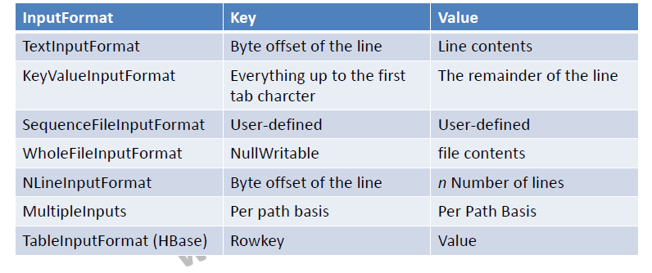

Slide 18
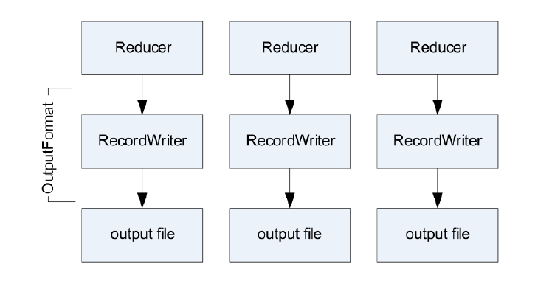
OutPutFormat

Slide 19
Some More info
IdentityMapper
mapping inputs directly to outputs
IdentityReducer
Performs no reduction, writing all input values directly to the output.
Single Reducer
Use when complete sort order is required
•Zero Reducer
SetNumReduceTasks to 0
Output from maps will go directly to OutputFormat and disk
No Sorting and Shuffling

Slide 20
Counters
for gathering statistics about the job
for quality control
for application level-statistics
Classified into two counters
Built In Counters
Task counters
Job Counters
Custom Counters

Slide 21
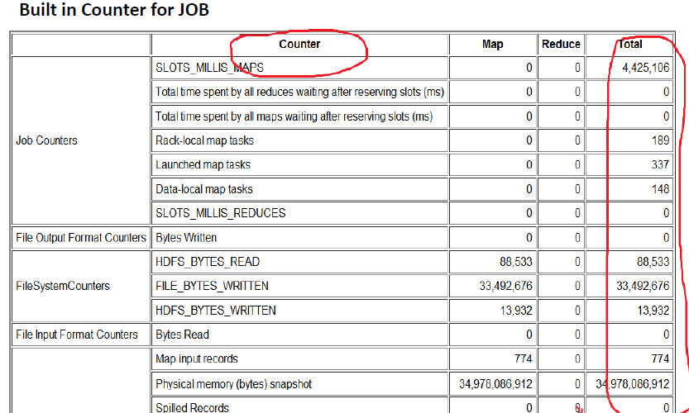

Slide 22
Side Data distribution
To keep some read only data available for all the tasks
Can be achieved using following two ways:
Configuration Object
DistributedCache
Configuration conf = new Configuration(); conf.set(“personName”,”kumar”);

Slide 23
Distributed Cache
Cache files and archive to the task nodes
Usage
As
DistributedCache API
public void addCacheFile(URI uri)
public void addCacheArchive(URI uri)
public void setCacheFiles(URI[] files)
public void setCacheArchives(URI[] archives)
public void addFileToClassPath(Path file)
public void addArchiveToClassPath(Path archive)
public void createSymlink()

Slide 24
Joins
To join data from Multiple datasets
Please try to use PIG or HIVE join if you are using text based files
Two varieties or approaches
Map-side Join
Reduce side Join

Slide 25
Map Side Join
Basic idea for Map-side joins:
Load one set of data into memory, stored in an associative array
Key of the associative array is the join key
Map over the other set of data, and perform a lookup on the associative array using the join key
If the join key is found, you have a successful join
Otherwise, do nothing

Slide 26
Reduce Side Join
Use the same key for the mapper output
Can be performed in two ways
MultipleInputs
Secondary Sort
MultipleInputs. MultipleInputs.addInputPath(job, InputPath, TextInputFormat.class, CustomMapper.class);

Slide 27
Sorting
In MR, keys from all mappers are sent to the reducers in sorting order
Total sorting can be obtained using single reducer
Reduces the performance
Partial sorting can be obtained using partition
For benchmarking , terasort has been widely used

Slide 28
Secondary Sorting
In MR sorting , the keys are sorted and not the values
To achieve the secondary sorting
Make the key a composite of the natural key and the natural value
The sort comparator should order by the composite key, that is, the natural key and natural value.
The partitioner and grouping comparator for the composite key should consider only the natural key for partitioning and grouping.
Example

